Slide 1
Optiver – 07
Meeting minutes &
Action point slides
Date: 27/04/2025 (Week 8)
Present: Ayush Singh, Christy Lee, Kylie Haryono, Zichun Han, Tobit Louis.

Slide 2
Pre-processing Pipeline
We finalized a comprehensive set of features (e.g. mid-price, spread, imbalance, micro-price, entropy, log-returns, realized volatility, bi-power variance, rolling integrated variance) to capture both static and dynamic market microstructure signals.
Standardized each 10-minute bucket to a fixed one-second timeline via full reindexing and forward-fill, ensuring uniform time grids and no missing observations across all feature streams.
Normalized and re-labelled identifiers by mapping original stock IDs and time buckets to sequential integers, enabling consistent merging, model input alignment, and downstream analysis.

Slide 3
Created Several Models
Parallelly, we also created several ML Models and tested them on a subset of dataset.
The Models we made: ANN-ARCH, CNN-LSTM, Lasso, LSTM, Random Forest, Ridge Regression, MHL-Neural Network, etc.
We also tested a few basic Models on our pipeline to check the accuracy.

Slide 4
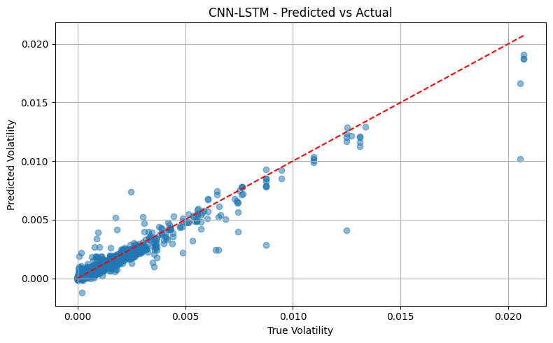

Slide 5
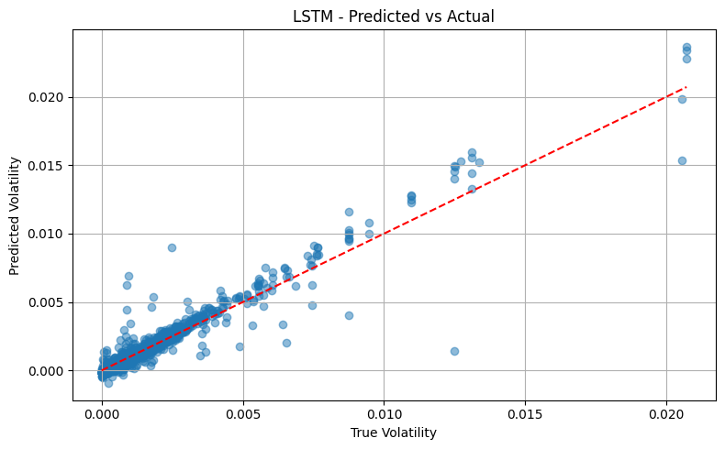

Slide 6
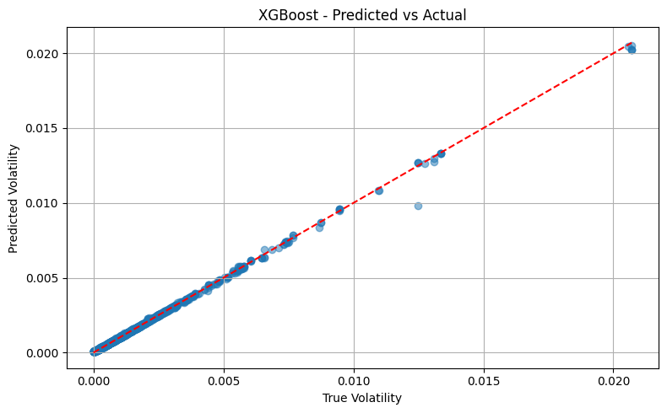

Slide 7
Problems
Missing seconds_in_buckets and how to handle them?
How to choose the final models and create an Ensemble of the Models?
How to avoid Overfitting?
How to scale this to 127 data-sets? (Online Learning)
How to choose the right features as they can be different for different ML models?

Slide 8
Next Steps– Week 09
We will finalize the pre-processing pipeline and features.
We will also create uniform code and comparative measure for all the models.
We will start Working on the model Ensemble and the performance metrics to compare them.
We will review the work we have done so far and add them to our presentation.

